Slide 1

Asynchronous Programming in C++
Techniques, Best Practices, and Real-World Applications

Slide 2
Agenda
Introduction to Asynchronous Programming
Definition, benefits, and common use cases.
Asynchronous Features in C++
Understanding futures, promises, std::async, and std::thread.
Advanced Asynchronous Patterns
Async I/O operations and thread pool implementation.
Best Practices
Avoiding pitfalls, resource management, and performance considerations.
Real-World Applications
Case studies, tools, and libraries to enhance asynchronous programming.
Q&A

Slide 3
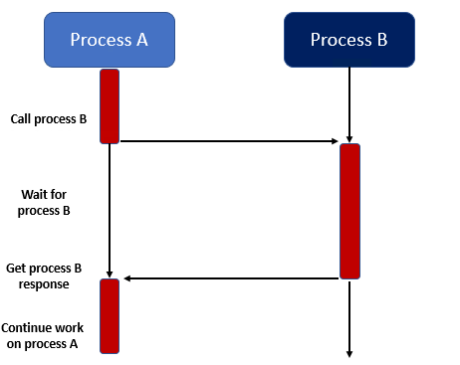
Introduction: Evolution of Programming Models
Early Days: Synchronous Programming
Tasks are executed sequentially, one after another.
Example: Reading a file before processing data, which
blocks further execution until the read is complete.
Limitations:
Inefficient use of CPU resources.
Long wait times for I/O operations.
Introduction of Multithreading
Running multiple threads in parallel within a single program.
Improved performance by utilizing multi-core processors.
Challenges:
Managing synchronization between threads.
Avoiding race conditions and deadlocks.

Slide 4
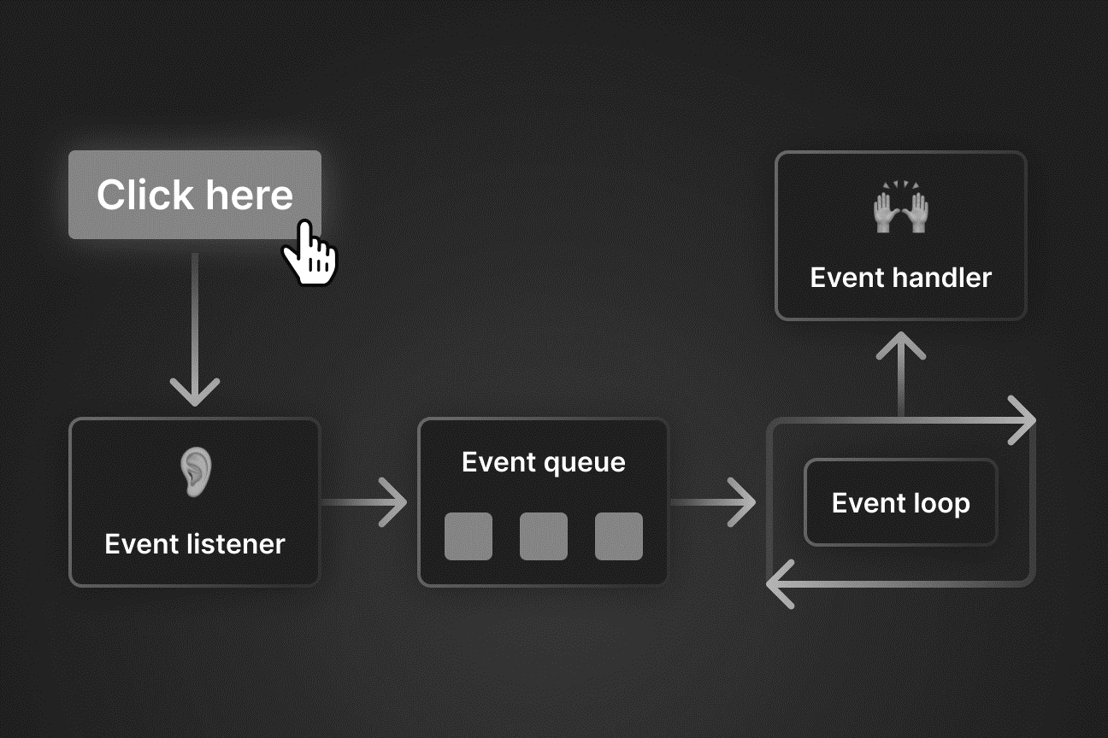
Introduction: Evolution of Programming Models
Event-Driven Programming
The flow of the program is determined by events such as user interactions or messages.
Uses an event loop to handle and dispatch events asynchronously.
Event Handlers: Handle specific events (e.g., onClick, onKeyPress).
Event handlers process events independently of the main
program flow.
Example: GUI applications and web servers that handle
multiple user interactions or requests.
Disadvantage: Cascading effects from interconnected events.

Slide 5
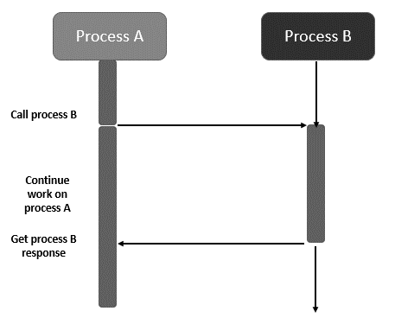
Introduction: Asynchronous programming
Asynchronous programming allows tasks to execute independently, without blocking the main program flow.
Independence: Asynchronous tasks run concurrently, improving responsiveness and resource utilization.
Non-blocking: While one task is active, others can proceed without waiting.
Interleaved execution: Even on a single processor, asynchronous code interleaves execution.
Benefits:
Responsiveness: Applications remain responsive during time-consuming operations (e.g., network requests).
Improved Performance: Tasks can be performed concurrently, making better use of system resources.
Scalability: Enables applications to efficiently handle increased workloads.

Slide 6
Introduction: Synchronous v/s Asynchronous
Practical Use Cases in Asynchronous Programming Model
UI Responsiveness: Background tasks like data loading without freezing the UI.
Concurrent Network Requests: Handling multiple client connections or API calls.
Efficient File/Database Operations: Performing I/O and queries without blocking the main thread.
Synchronous | Asynchronous
Tasks are executed one after another, blocking until the previous task completes. | Tasks can run concurrently, allowing other tasks to proceed while waiting.
Can block the main thread, leading to potential unresponsiveness in applications. | Enhances responsiveness by allowing the main thread to remain active while waiting for tasks to complete.
Limited by sequential execution; may not fully utilize multi-core processors. | Efficiently utilizes system resources and multi-core processors by running tasks in parallel.

Slide 7
Asynchronous Features in C++: thread, async
C++ provides powerful features for managing asynchronous tasks.
std::thread
Purpose: Provides a way to create and manage threads.
Usage: Allows execution of functions in parallel.
Example:
std::async
Purpose: Provides a high-level mechanism to run functions asynchronously.
Automatically manages threads and returns a future object to retrieve results.
Example:
std::thread t([]() { // Task to run concurrently }); t.join(); // Wait for thread to finish
auto future = std::async(std::launch::async, []() { // Task to run asynchronously return result; }); auto result = future.get(); // Retrieve result

Slide 8
Asynchronous Features in C++: promise
std::promise
Purpose: Sets a value or exception to be retrieved by a std::future.
Used by the producer/writer of an asynchronous operation.
Usage: Provides a way for one thread to communicate results or exceptions to another.
Methods:
set_value(value): Sets the result for the associated std::future.
set_exception(exception): Sets an exception for the associated std::future.
Example:
auto promise = std::promise<std::string>(); auto producer = std::thread([&] { promise.set_value("Hello World"); });

Slide 9
Asynchronous Features in C++: future
std::future
Purpose: Retrieves the result of an asynchronous operation.
Used by the consumer/reader of an asynchronous operation.
Usage: Obtained from std::async, std::promise, or other asynchronous mechanisms.
Methods:
get(): Blocks until the result is available and returns the result.
wait(): Blocks until the result is available without returning it.
valid(): Checks if the std::future is valid.
Example:
Demo1 to Demo5
auto future = promise.get_future(); auto consumer = std::thread([&] { std::cout << future.get(); });

Slide 10
Asynchronous Features in C++: Misc…
std::packaged_task
Purpose: Wraps a callable object to be executed asynchronously.
Usage: Creates a std::future and associates it with a task.
Example:
std::condition_variable
Purpose: Synchronizes threads by allowing them to wait for certain conditions.
Usage: Used in conjunction with std::mutex for thread coordination.
Example: Demo 6 and Demo 7
std::shared_future
Purpose: Allows multiple threads to share the result of a single asynchronous operation.
Usage: Can be copied and accessed by multiple threads.
Example: Demo 8
std::packaged_task<int(int)> task([](int x) -> int{ return x * x; // Task to run }); std::future<int> future = task.get_future(); std::thread t(std::move(task), 5); t.join(); int result = future.get(); // Retrieve the result

Slide 11
Advanced Asynchronous Patterns
Async I/O Operations
Asynchronous I/O (Input/Output) allows non-blocking communication with files, sockets, or other resources.
Improve application responsiveness and throughput.

Slide 12
Async I/O Operations: Key Libraries & APIs
Boost.Asio
Description: A cross-platform C++ library for network and low-level I/O programming.
Features:
Asynchronous Operations: Provides asynchronous read/write for sockets and files.
Timers: Supports asynchronous wait operations on timers.
Signals: Handles asynchronous signal handling.
Advantages:
Portability: Works on multiple platforms.
Comprehensive Documentation: Well-documented and widely used in the industry.
Example: Demo9 and Demo10

Slide 13
Async I/O Operations: Key Libraries & APIs
Windows APIs
OVERLAPPED I/O:
Description: Uses the OVERLAPPED structure to perform asynchronous file and network I/O.
Functions: ReadFileEx, WriteFileEx.
Advantages:
Integration: Seamlessly integrates with the Windows operating system.
Performance: Optimized for Windows environments.
Example:
HANDLE file = CreateFile("example.txt", GENERIC_READ, 0, NULL, OPEN_EXISTING, FILE_FLAG_OVERLAPPED, NULL); OVERLAPPED ol = {}; char buffer[1024]; ReadFileEx(file, buffer, sizeof(buffer), &ol, [](DWORD dwErrorCode, DWORD dwNumberOfBytesTransfered, LPOVERLAPPED lpOverlapped) { // Handle async read completion }); SleepEx(INFINITE, TRUE); // Wait for completion

Slide 14
Async I/O Operations: Key Libraries & APIs
POSIX APIs
Async Functions:
Description: Standardized API for asynchronous I/O operations in POSIX-compliant systems.
Functions: aio_read, aio_write.
Advantages:
Portability: Available on various Unix-like systems.
Simplicity: Simple API for basic asynchronous operations.
Example: Demo11

Slide 15
Async I/O Operations: Key Libraries & APIs
Linux Specific: io_uring
Description: A modern asynchronous I/O interface for Linux, designed for high-performance applications.
Features:
Efficiency: Minimizes system calls and context switches.
Scalability: Handles a large number of I/O operations efficiently.
Advantages:
Performance: Superior performance for high I/O workloads.
Flexibility: Suitable for various asynchronous tasks.
Example: Demo12

Slide 16
Thread Pool Implementation
What is a Thread Pool?
Definition: A collection of pre-instantiated, idle threads ready to perform tasks.
Purpose: Reuse threads for multiple tasks, reducing the overhead of thread creation and destruction.
Benefits: Improved performance, efficient resource utilization, better control over concurrency.
Benefits of Using a Thread Pool
Reduced Latency: Tasks are executed immediately without waiting for a new thread to be created.
Controlled Concurrency: Limits the number of concurrent threads, preventing system overload.
Resource Efficiency: Threads are reused, reducing the overhead associated with thread creation and destruction.
Example: Demo13

Slide 17
Best Practices
Avoiding Pitfalls:
Deadlocks:
Consistent locking order.
Use std::lock for multiple locks.
Employ lock hierarchies.
Race Conditions:
Protect shared data with mutexes.
Use atomic operations.
Thread-safe data structures.
Resource Management: RAII (Resource Acquisition Is Initialization):
Encapsulate resources in objects.
Automatic resource release.
Smart Pointers:
std::unique_ptr for exclusive ownership.
std::shared_ptr for shared ownership.
Avoid raw pointers.

Slide 18
Best Practices
Performance Considerations:
Minimizing Context Switching:
Reuse threads with thread pools.
Batch small tasks.
Efficient Task Scheduling:
Work-stealing algorithms.
Balanced workload.
Prioritize tasks.

Slide 19




THANK YOU
Do you have any questions?
pratikparvati@gmail.com
https://pratikparvati.com/

